Slide 1
Michelle Cheatham
PhD Student
Wright State University
Michelle.cheatham@gmail.com
Primary Research or Practice Area(s):
• Semantic Web
• Linked Open Data
• Ontology Alignment
Previous Experience
• The Digital Earth as Knowledge Engine. Krzysztof Janowicz, Pascal Hitzler, Semantic Web 3 (3), 213-221, 2012.
• Yingjie Hu, Krzysztof Janowicz, David Carral, Simon Scheider, Werner Kuhn, Gary Berg-Cross, Pascal Hitzler, Mike Dean
A Geo-Ontology Design Pattern for Semantic Trajectories.
In: Proceedings of COSIT 2013, Conference on Spatial Information Theory, Scarborough, UK, September 2013. To appear.
Contact Information:
Department of Computer Science and Engineering
Wright State University
3640 Colonel Glenn Highway
Dayton, OH 45435
csdr-nd: sustainability data community forum
Workshop I – July 18-19, 2013
Chicago, Illinois

Slide 2
Sustainable Development and the Internet of Things
Michelle Cheatham
Kno.e.sis Center
Wright State Univ

Slide 3
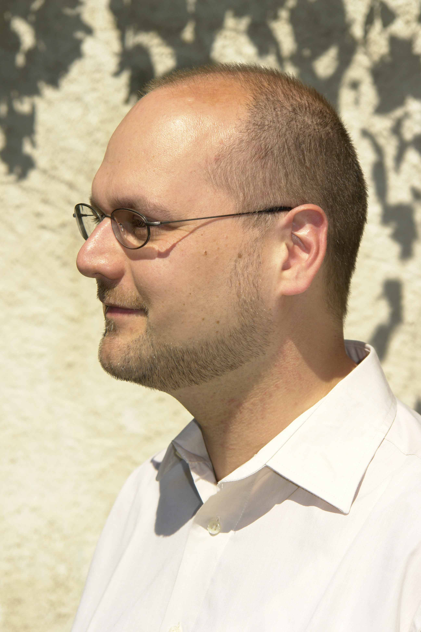
Who are you?

Slide 4
What are you going to talk about?
What are the Semantic Web and the Internet of Things?
What resources and applications currently exist?
What are some current research trends in this area?
Please interrupt with any questions or comments
Please contact me if you have any thoughts on semantic web-related sustainability applications

Slide 5
How is this Relevant?

Slide 6
The Internet Could Be Better
The Semantic web is a web of data that can be processed directly and indirectly by machines. – Tim Berners-Lee, “The Semantic Web”, Scientific American, 2001.
Today’s Web | The Semantic Web
Links between web pages (documents) | Links between concepts (data)
Understanding requires natural language processing and background knowledge | Understanding requires following links and reasoning over logical formalisms
Content and Presentation are mixed | Content and Presentation are distinct
Tags include “table”, “heading” and “font” | Tags include “subClassOf”, “sameAs”, and “disjointFrom”

Slide 7
The Internet of Things
Everyday objects have an Internet presence
In 2008 the number of devices connected to the Internet passed the number of people
Similar to pervasive and ubiquitous computing
Enabling technologies include RFID tags, EPC, and embedded sensors

Slide 8
Smart Power Grids
Zhou, Qunzhi, Yogesh Simmhan, and Viktor Prasanna. "Incorporating semantic knowledge into dynamic data processing for smart power grids." The Semantic Web–ISWC 2012. Springer Berlin Heidelberg, 2012. 257-273.
USC’s campus has over 170 buildings with around 50,000 sensors measuring things like room temperature, HVAC airflow and fan speed, and CO₂ levels every minute
Data is published as RDF triples; sensors, buildings, users, departments, weather, etc. is described in an ontology
A semantic-aware complex event processor is used to dynamically respond during peak load periods
Queries such as “Alert me when the space temperature in a non-occupied meeting room is lower than the green building temperature”

Slide 9
Traffic Congestion
Lécué, Freddy, Anika Schumann, and Marco Luca Sbodio. "Applying semantic web technologies for diagnosing road traffic congestions." The Semantic Web–ISWC 2012. Springer Berlin Heidelberg, 2012. 114-130.
IBM’s group in Dublin, Ireland are attempting quasi-real time diagnosis of traffic congestion for remediation
Data includes Dublin bus positions, weather, road works and maintenance, and city events (concerts, soccer matches, etc.)
Existing systems can detect traffic congestion and use probabilistic finite state machines to diagnose the cause, but only if it is exactly the same as something seen previously
Ontologies and RDF wrappers for the data sources allow recognition of similar but not identical causes

Slide 10
Semantic Sensor Network ONtology
Compton, Michael, et al. "The SSN ontology of the W3C semantic sensor network incubator group." Web Semantics: Science, Services and Agents on the World Wide Web 17 (2012): 25-32.
Describes sensor capabilities, measurement processes, observations, and deployments
Focused on four use cases: data discovery and linkage, device discovery and selection, provenance and diagnosis, and device operation, tasking and programming
Based on the Stimulus-Sensor-Observation ontology design pattern
Applications based on this ontology include a system developed to support energy forecasts for manufacturing processes
K. Wenzel, J. Riegel, A. Schlegel, M. Putz, Semantic Web Based Dynamic Energy Analysis and Forecasts in Manufacturing Engineering, in: Proceedings of the 18th CIRP International Conference on Life Cycle En- gineering, Springer-Verlag, 507–512, 2011.

Slide 11
Research Trends
Modeling new domains (using ontology design patterns)
Handling heterogeneous data
Adding semantic layers to existing data mining, machine learning, and reasoning systems

Slide 12
Questions?
Michelle Cheatham
PhD student, Kno.e.sis Center, Wright State University
michelle.cheatham@gmail.com
Dr. Pascal Hitzler
Associate Professor, Kno.e.sis Center, Wright State University
pascal.hitzler@wright.edu
http://knoesis.wright.edu/pascal/index.html

